Slide 1
What is incivility?

Slide 2

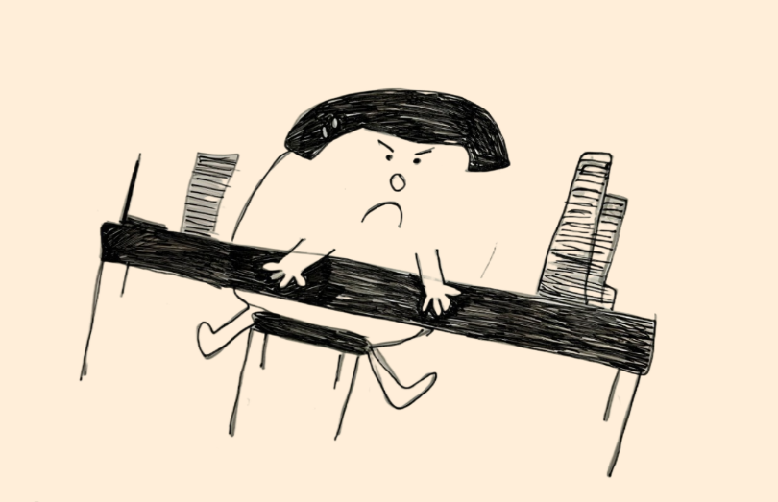

Insulting Comments
Bad Manners
False Rumors
Social Isolation
Not Giving Credit
Gossiping
Crude Jokes

Slide 3
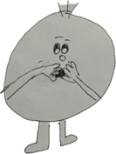
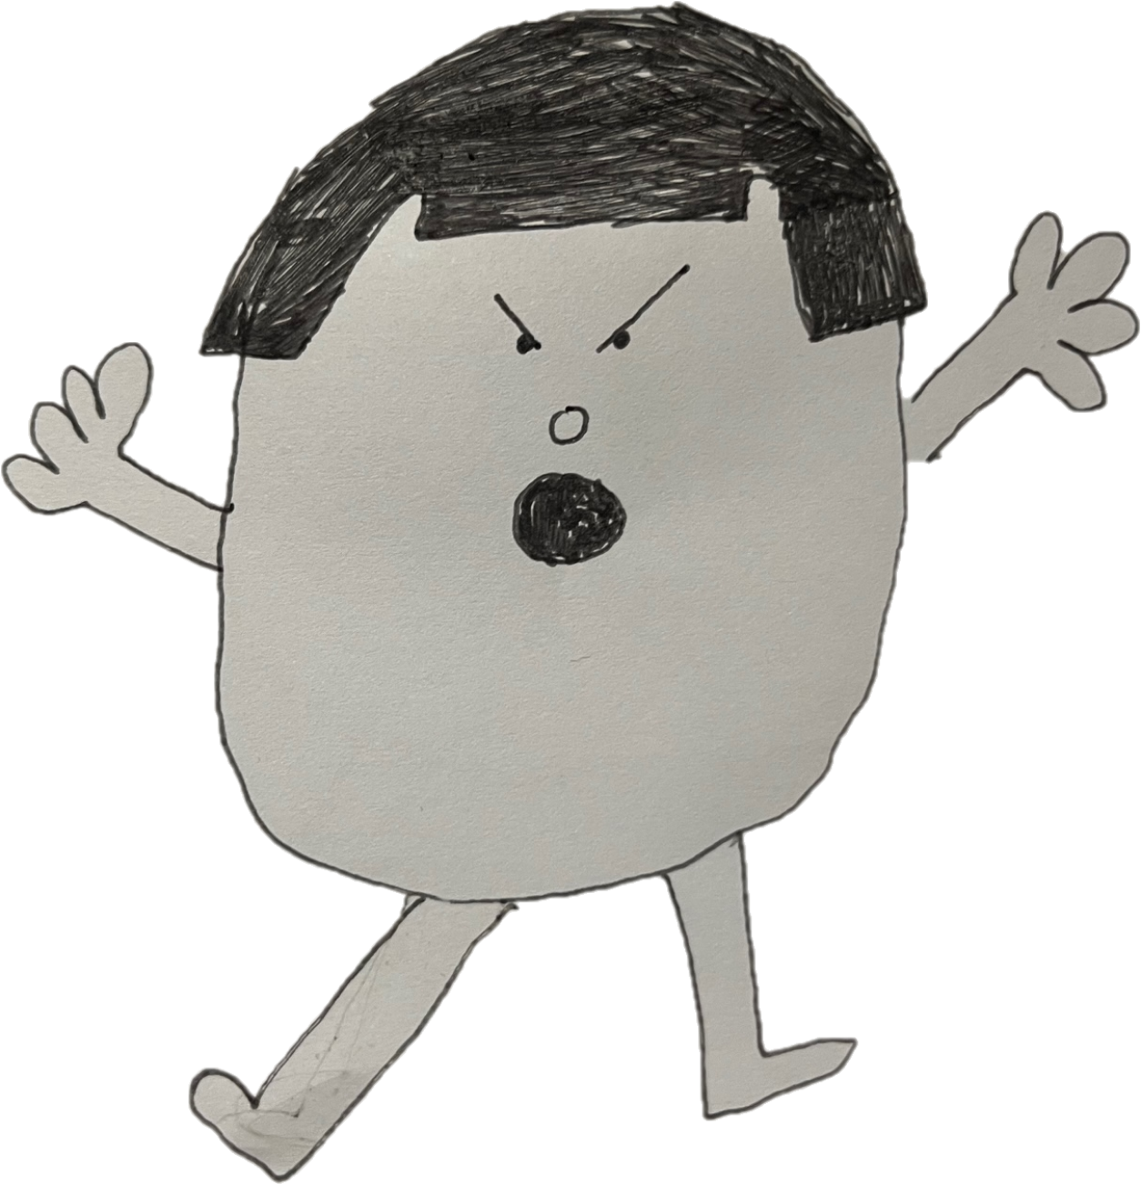
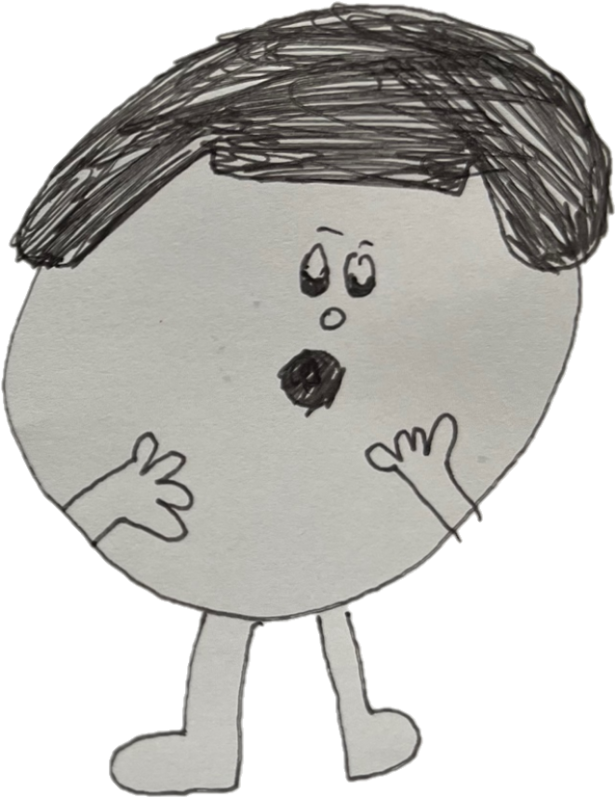
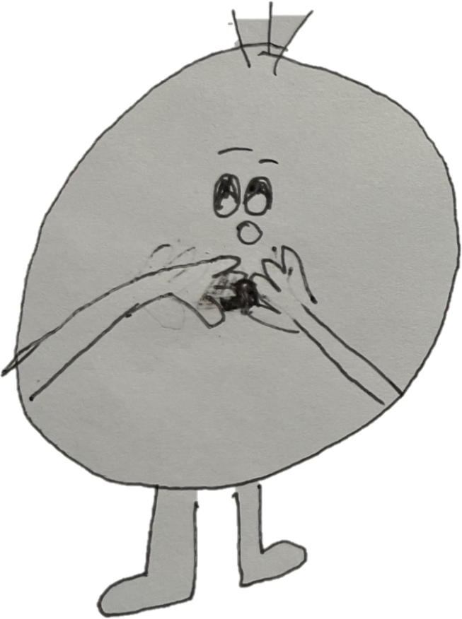

Slide 4
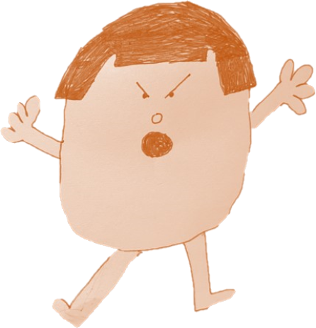
Perception
Tolerance
&

Slide 5

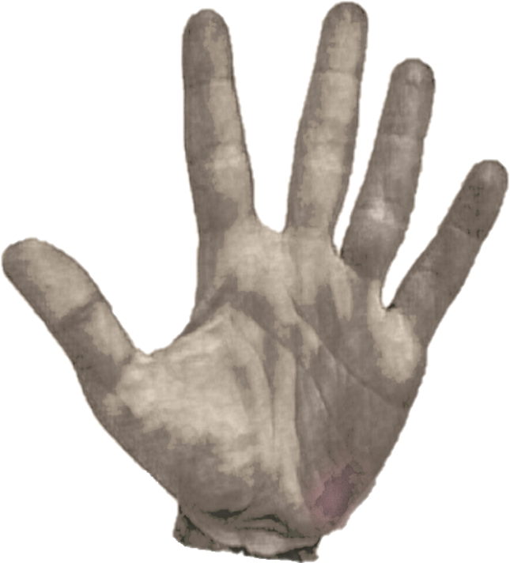
The MOUTZA

Slide 6
Uncivil Behavior
98%
Treated Rudely
Once a week
2011: 50%
1998: 25%
(The Price of Incivility, Harvard Business Review, 2013)

Slide 7
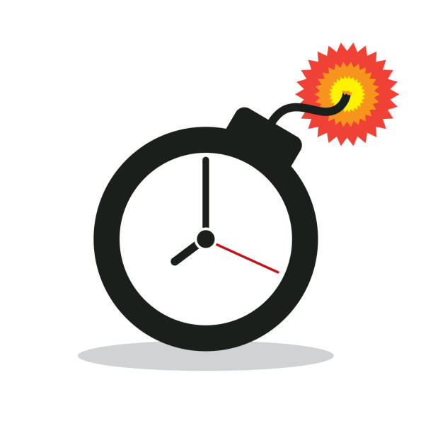
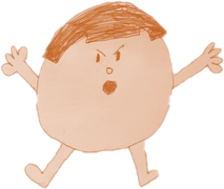
Incivility Βullying
Holm, K., Torkelson, E. & Bäckström, M. Workplace incivility as a risk factor for workplace bullying and psychological well-being: a longitudinal study of targets and bystanders in a sample of swedish engineers. BMC Psychol 10, 299 (2022). https://doi.org/10.1186/s40359-022-00996-1

Slide 8
Effects of incivility in the workplace

Slide 9

Poll of 800 managers and employees in 17 industries
on Customers
25%
Frustration
38%
Quality, effort, time decreased
63%
Lost work time avoiding the offender
66%
Performance declined
78%
Commitment declined
80%
Lost work time worrying
(The Price of Incivility, Harvard Business Review, 2013)

Slide 10
Lead by example
Hire for civility
Culture
Values
Principles
Penalize bad behavior
Teach civility
Reward good behavior

Slide 11
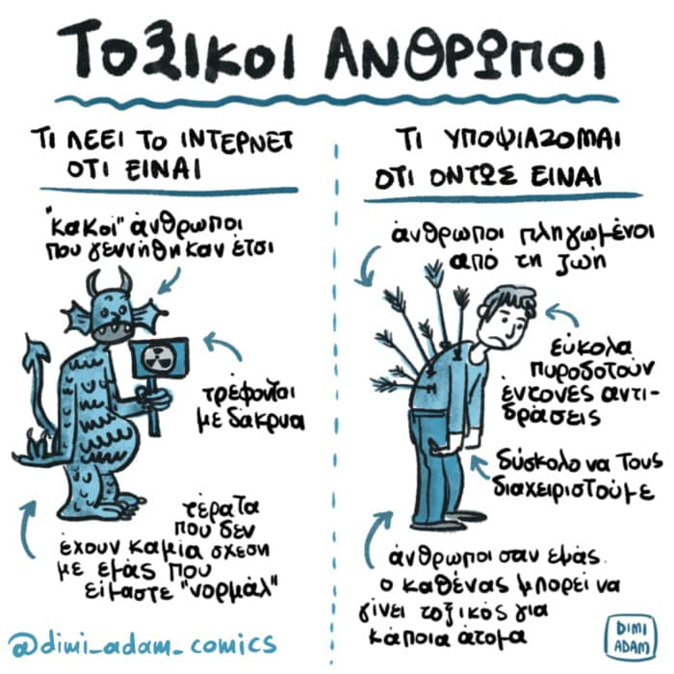

Slide 12

“…some of us are so overwhelmed by our responsibilities at work that we may not even realize that we are being rude or uncivil to others…”
Dr. Christine Porath
Georgetown University
(What’s Behind A Rise in Workplace Bullying?, USA Today, 2013)

Slide 13
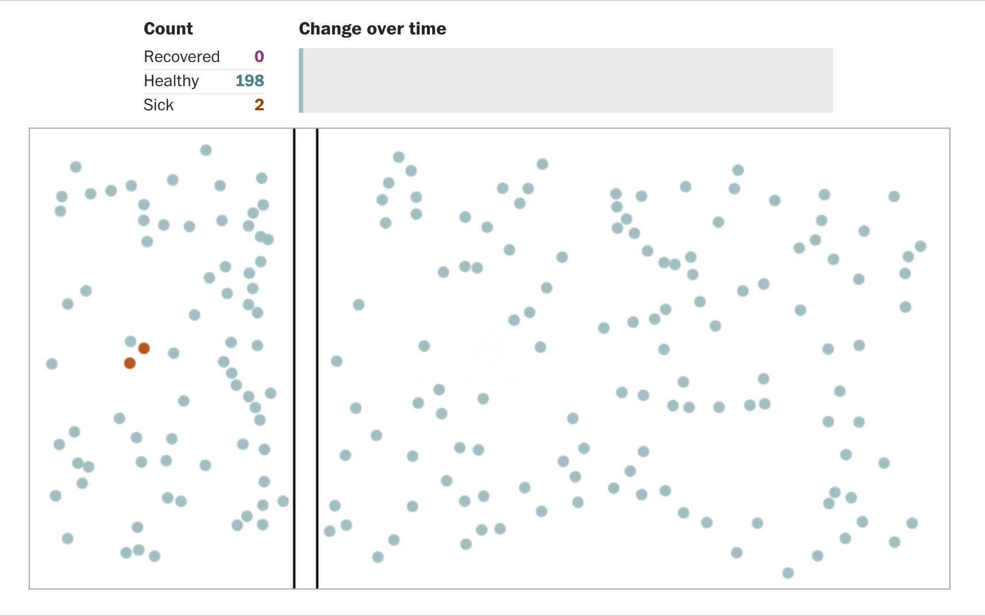

Slide 14
