Slide 1


Transforming Total Rewards
Speaker: Mrs.Vassiliki Marinou
Group Compensation & Benefits Manager
Alumil Group
Vassiliki Marinou

Slide 2
61%
of employees are considering a job hunt
Source: Achievers 2023 Engagement and Retention Report
#1
Career Progression & Work Flexibility
#2
Compensation
why?
re:define
#3
Don’t feel valued at work

Slide 3



Total Rewards are a key enablers for attracting, motivating, retaining and engaging Talent
56% of organisations are raising salaries to attract and retain Talent
72% of organisations are introducing remote working or flexible work location
Source: PayScale 2023 Compensation Best Practice Report

Slide 4
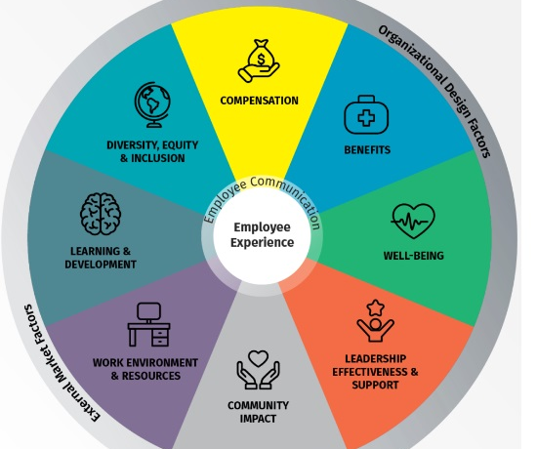
The 8 pillars of People Experience:

Slide 5

A changing landscape: New demands & principles
Offering Choice
Interactive, Inclusive, Flexible
Requesting Feedback from people
Personalised and relevant to people’s needs
Simple, Transparent, Understandable
Sustainable
Foster a culture of continuous feedback, coaching, and recognition
Focused on talent investment, skills, potential and meaningful career progression
Moving from rigid grading systems to more flexible career streams
    Non-hierarchy-based benefits
Continuous communication
Giving people what they value, pay the person not the role

Slide 6

The shift of Total Rewards
Sustainability & DEIB “nice to have” initiative
Sustainability & DEIB as key enablers for attracting and retaining
Irregular, reactive and not holistic wellbeing initiatives
Proactive, regular and holistic wellbeing initiatives
Embracing AI & Automation to take data-driven decisions
Digitalization
Rewards applied
“one size fits all”
Rewards personalized and aligned to co-worker’s preferences

Slide 7
The shift of Total Rewards
Office-based workplace
Flexible workplace and remote or/ and hybrid work environments offering choice to co-workers
Predefined and rigid working hours and days
Flexible and asynchronous working hours offering choice to co-workers
Traditional employment one employer at a time
Offering flexible employment focusing on people’s needs
Job roles and career paths predefined and hierarchical
Agile work with career paths based on skill, experience and potential. Nonlinear careers.

Slide 8

















Evolution from Total Rewards to Employee Value Proposition
Learning Upskilling Reskilling
Tools to leverage
Career path management & mobility
Total Rewards Strategy
Base pay
Talent Management
Rewards
Total Rewards Elements:
Compensation
Benefits
Wellbeing
Recognition
Development
Continuous coaching & feedback
Time off programs
Performance Management
Stock options
Recognition
Sustainable Monetary and non-monetary incentives
Culture, Purpose,
Sustainability, Wellbeing & DEIB
Health care program
Holistic Wellbeing
Pension program
Work flexibility
Communication, transparency & branding

Slide 9

“I want to feel valued,
recognised,
fairly rewarded and that I lead a purposeful job”
Vassiliki Marinou

